Slide 1
Design Project: Team 11
Final Presentation

Slide 2
Table of Contents
01
02
03
04
05
06
Introductions
Company Overview
Simplified EER Diagram
Relational Schema
Normalization Analysis
Interesting Queries

Slide 3
Team 11 Members
Angelo Punzalan
Joan Suwandi
Anahy Sorto Garcia
Brooke Soobrian
Chiraphat Techasiri
Leyla Siminou
Kaan Taner
Timea Ryan
Members | Company Overview | Simplified EER | Project Schema | Queries

Slide 4
Company Overview

Slide 5
Popper: Company Overview
Business Model
App to discover local events and connect with people who share your interests
The app can accommodate 1000 beta users, 50 for first launch, 200 for next month
Gamification:
In-person interactions are similar to a game where you rack up “popper points” and enjoy free vouchers for perks like free drinks or food
Feed System (think of BeReal)
Limits users to only connect with other people before they are allowed to post on their feed
Events Feed
Events that friends share and public events being hosted through partnerships
Members | Company Overview | Simplified EER | Project Schema | MySQL | Queries | Normalization

Slide 6
Popper: Company Overview (cont.)
Current Database System
Uses Google NoSQL, providing a flexible, scalable database solution that is ideal for handling large amount of unstructured data
Data is stored at the shallowest node, ensuring quick data retrieval and update
The current database is designed to effectively handle a large volume of documents, up to 1000 at the root node
Project Goal
Create a more thorough database with an extensive list of entities (ex. city, comments, employees, etc.)
Organize it more comprehensively by dividing into 4 root nodes- friends, posts, users, pops
Members | Company Overview | Simplified EER | Project Schema | MySQL | Queries | Normalization

Slide 7
Simplified EER Diagram

Slide 8
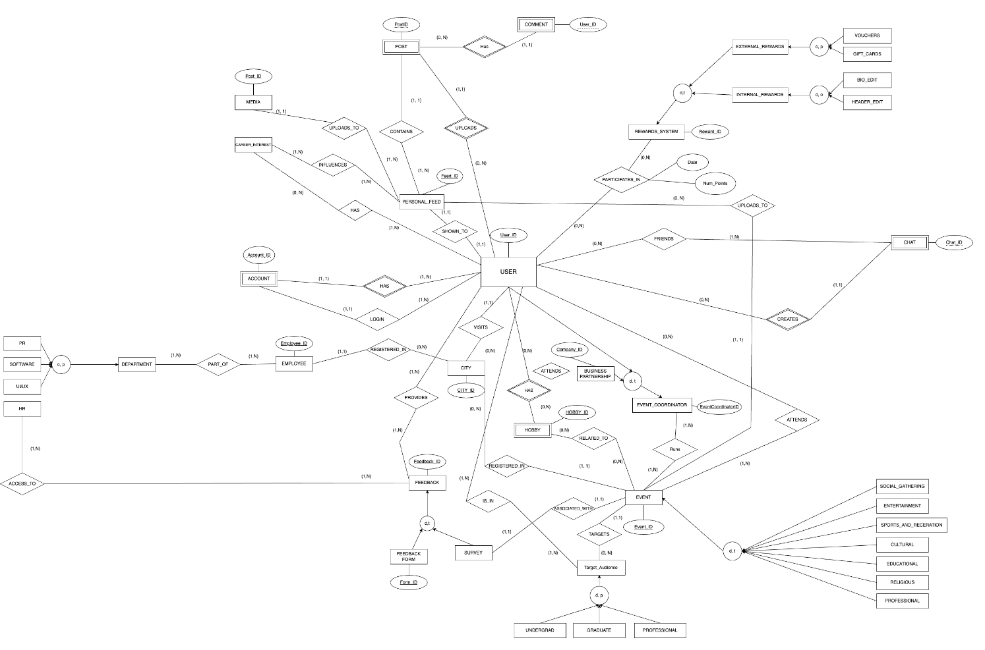
Simplified EER Diagram
Members | Company Overview | Simplified EER | Project Schema | MySQL | Queries | Normalization

Slide 9
Project Schema

Slide 10
Design Project Schema
1). USER (User_ID, Name, Email, Location, Age, Gender, City_ID⁵)
2). PERSONAL_FEED (Feed_ID, Recommendations)
3). FEEDBACK (Feedback_ID, Timestamp)
3.1). FEEDBACK_FORM (Form_ID, Feedback_ID⁴, Num_questions,
Anonymous)
3.2). SURVEY (Event_ID¹¹, Feedback_ID⁴, Avg_app_rating,
Avg_event_rating)
4). MEDIA (Post_ID, Content, User_ID, Media_Timestamp, Feed_ID²)
5). CITY (City_ID, Num_Users, State)
6). REWARDS_SYSTEM(Reward_ID, Points_Required, Description)
6.1). INTERNAL_REWARDS(Internal_Reward_ID, Reward_ID⁶, Points_required)
6.1.1). BIO_EDIT(Bio_Edit_ID, Internal_Reward_ID^{6.1}, Reward_ID⁶,
Max_characters, Fields)
6.1.2). HEADER_EDIT(Header_Edit_ID, Internal_Reward_ID^{6.1}, Reward_ID⁶,
Header_size, Num_Previous_Edits)
6.2). EXTERNAL_REWARDS(External_Reward_ID, Reward_ID⁶, Reward_Amount)
6.2.1). VOUCHERS(Voucher_ID, External_Reward_ID, Reward_ID⁶,
Restaurant_Name, Voucher_Amount, Number_times_redeemed)
6.2.2). GIFT_CARDS(Gift_Card_ID, External_Reward_ID, Reward_ID⁶,
Store_Name, Amount, Number_times_redeemed)
7). CAREER_INTEREST(Career_ID, Career_Field, Avg_years_experience)
8). EMPLOYEE(Employee_ID, FName, LName, MInit)
Members | Company Overview | Simplified EER | Project Schema | MySQL | Queries | Normalization

Slide 11
Design Project Schema (cont.)
9). DEPARTMENT(Department_ID, Num_employees, Sub_departments)
9.1). PR(Department_ID⁹, Active_Social_Media, Trend_analyses)
9.2). SOFTWARE(Department_ID⁹, Languages, Frontend, Backend)
9.3). UI/UX(Department_ID⁹, Study_findings, Feature_ideas)
9.4). HR(Department_ID⁹, Complaints, Meeting_records)
10). EVENT_COORDINATOR(Event_Coordinator_ID, FName, LName, MInit, Company)
10.1). BUSINESS_PARTNERSHIP(Company_ID, Event_Coordinator_ID¹⁰,
Num_years, Previous_work)
10.2). USER(User_ID, Event_Coordinator_ID¹⁰, Roles, Num_events_hosted)
11). EVENT(Event_ID, Time, Date, City, Category, Description, Num_Attendees, City_ID⁵, Target_ID ¹²)
11.1). SOCIAL_GATHERING(EVENT_ID¹¹, Max_size, Outdoor_or_indoor)
11.2). ENTERTAINMENT(EVENT_ID¹¹, Venue, Age_range)
11.3). SPORTS_AND_RECREATION(EVENT_ID¹¹, Sport, Teams)
11.4). CULTURAL(EVENT_ID¹¹, Target_culture, Activities)
11.5). EDUCATIONAL(EVENT_ID¹¹, Level_Education)
11.6). RELIGIOUS(EVENT_ID¹¹, Main_religion)
11.7). PROFESSIONAL(EVENT_ID¹¹, Duration, Description)
Members | Company Overview | Simplified EER | Project Schema | MySQL | Queries | Normalization

Slide 12
Design Project Schema (cont.)
12). TARGET_AUDIENCE(Target_ID, Region, Age_range)
12). UNDERGRAD(Target_ID¹², Major, University, Concentration, Academic_Year)
12). GRADUATE(Target_ID¹², University, Research_interests)
12). PROFESSIONAL(Target_ID¹², Company, Position, Years_experience)
13). ACCOUNT (Account_ID, User_ID¹Creation_Date, Last_Login_Date, Has_User_ID¹, Login_User_ID¹)
14). CHAT (Chat_ID, User_ID¹, Message_Text, No_Participants, Creates_User_ID¹)
15). POST (Post_ID, User_ID¹,Liked_By, User_ID, Content, Timestamp, No_Likes, Uploads_User_ID¹, Contains_Feed_ID²)
16). COMMENTS (User_ID, Post_ID⁸, User_ID¹, No_Likes, Liked_By, Text, Post_ID⁸)
17). HOBBY(Hobby_ID, User_ID¹, Description)
18). ACCOUNT(Account_ID, User_ID¹, Settings)
19). SHOWN_TO (User_ID¹, Feed_ID², Previous_likes, Previous_engagements)
20). ASSOCIATED_WITH(Event_ID¹¹, Feedback_ID⁴, Event_category, Event_average_rating, Num_reviews)
Members | Company Overview | Simplified EER | Project Schema | MySQL | Queries | Normalization

Slide 13
Design Project Schema (cont.)
21). FRIENDS (User_ID¹, Chat_ID¹⁰, Num_chats, Hrs_online)
22). PROVIDES_FEEDBACK (Feedback_ID³, User_ID¹, Num_Reports, User_average_rating)
23). INFLUENCES(Career_ID⁷, Feed_ID², Career_goals)
24). HAS(Career_ID⁷, Feed_ID², Engagement_score, Active)
25). PART_OF(Employee_ID⁸, Department_ID⁹, Previous_Department, Supervisor)
26). REGISTERED_IN(Employee_ID⁸, City_ID⁵, Neighborhood, Main_region)
27). ACCESS_TO(Feedback_ID³, Department_ID⁹, Number_reviewed, Category)
28). IS_IN(User_ID¹, Target_ID¹², Age_group, Region)
29). ATTENDS(User_ID¹, Event_ID¹¹, Previously_attended, Enjoyed)
30). HAS_HOBBY(User_ID¹, Hobby_ID¹⁷, Years_experience, Influences)
31). HOBBY_RELATED_TO(Hobby_ID¹⁷, Event_ID¹¹, Career_category, Interests)
32). RUNS(Event_ID¹¹, Event_Coordinator_ID¹⁰, Previous_events, Average_event_rating)
33). PARTICIPATES_IN(User_ID¹, Reward_ID⁶, Num_points, mutual_connections)
Members | Company Overview | Simplified EER | Project Schema | MySQL | Queries | Normalization

Slide 14
MySQL WorkBench

Slide 15
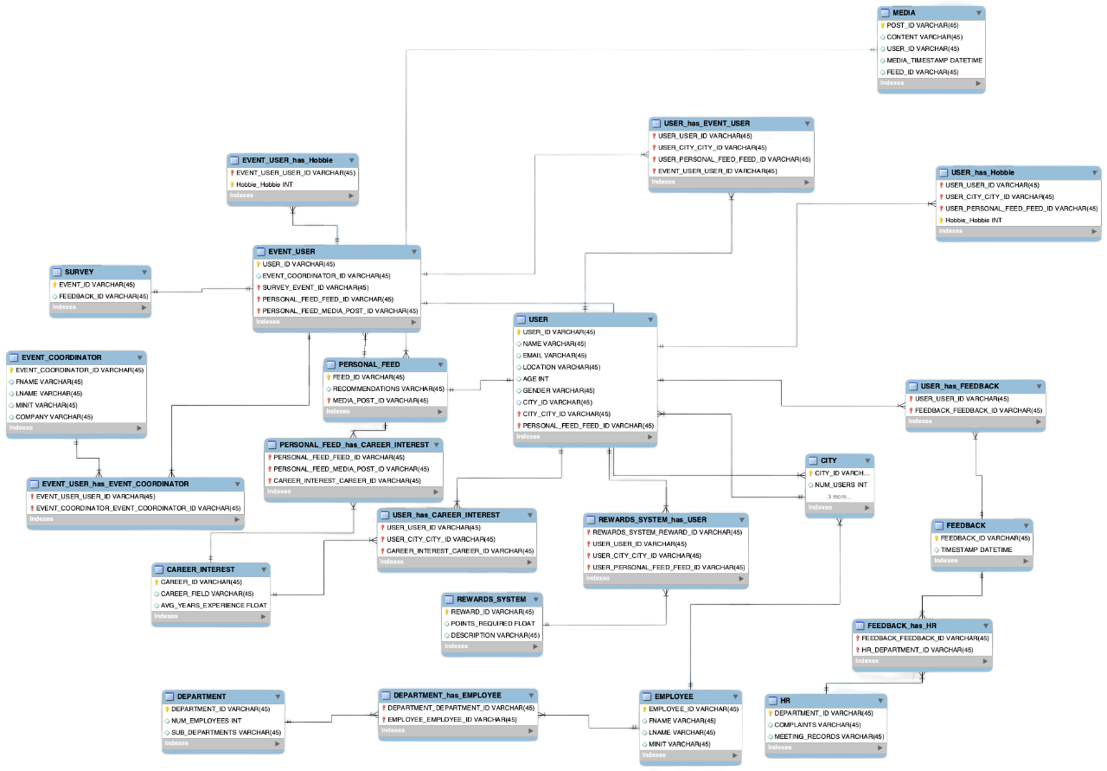
MySQL Workbench
Members | Company Overview | Simplified EER | Project Schema | MySQL | Queries | Normalization

Slide 16
Queries

Slide 17
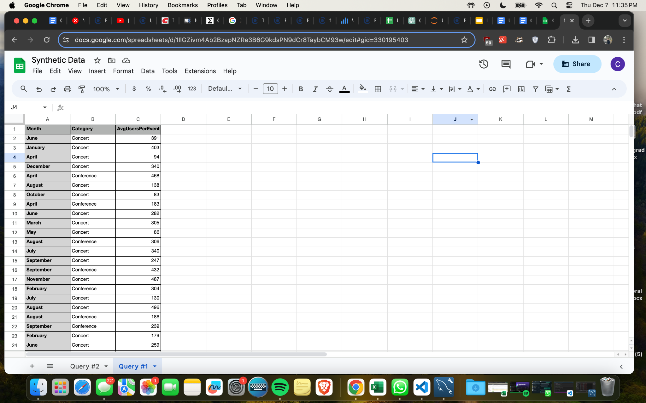
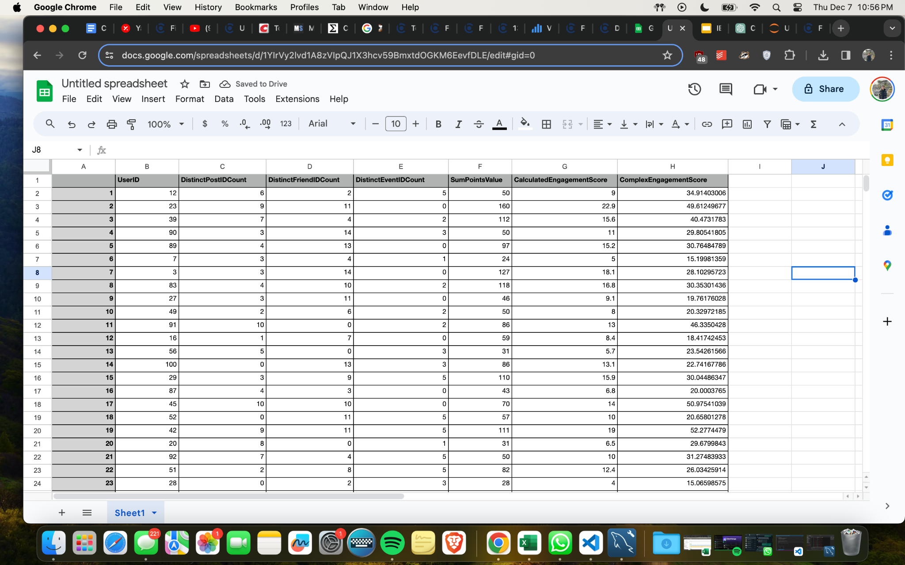
Data Generation Process
Initial Data Generation
The creation of synthetic data used Python’s Faker library and exporting that data as a CSV file
Processing Queries
Using the Data Analysis model of ChatGPT it was able to query the data and provide the result as a CSV file
Members | Company Overview | Simplified EER | Project Schema | MySQL | Queries | Normalization

Slide 18
Interesting Query #1
Description
Determine the event category that would attract the most users, from there, increase efforts to host more of such events to further participation and engagement. Take the average number of users per event category per month. Compare the number of users per event category across different months
Query
SELECT
EXTRACT(MONTH FROM e.Date) AS Month,
e.Category,
AVG(e.Num_attendees) AS AvgUsersPerEvent
FROM EVENT e
JOIN ATTENDS a ON e.Event_ID = a.Event_ID
GROUP BY EXTRACT(MONTH FROM e.Date), e.Category
ORDER BY EXTRACT(MONTH FROM e.Date), e.Category;
Members | Company Overview | Simplified EER | Project Schema | MySQL | Queries | Normalization
Notes:
Take the average number of users per event category per month. Compare the number of users per event category across different months. From this data, we can determine the event category that would attract the most users, from there, increase efforts to host more of such events.

Slide 19
Interesting Query #1
Members | Company Overview | Simplified EER | Project Schema | MySQL | Queries | Normalization
Notes:
Take the average number of users per event category per month. Compare the number of users per event category across different months. From this data, we can determine the event category that would attract the most users, from there, increase efforts to host more of such events.

Slide 20
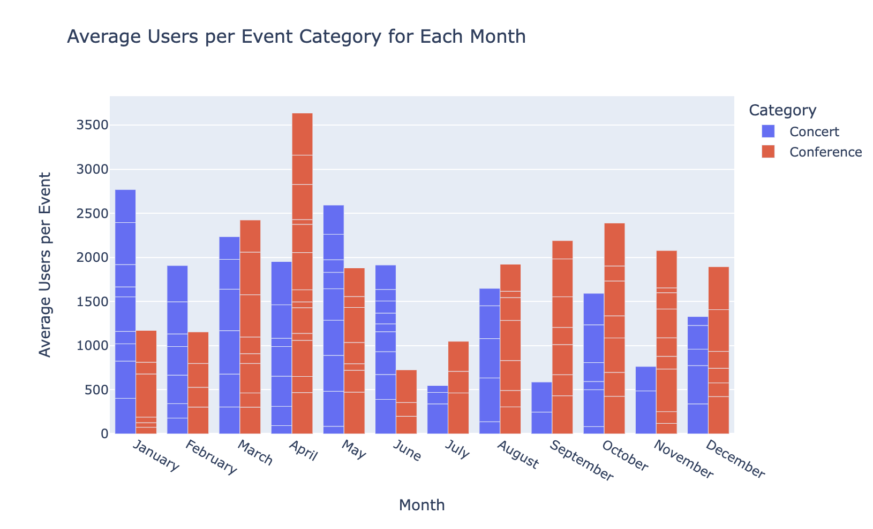
Interesting Query #1 (cont.)
Members | Company Overview | Simplified EER | Project Schema | MySQL | Queries | Normalization

Slide 21
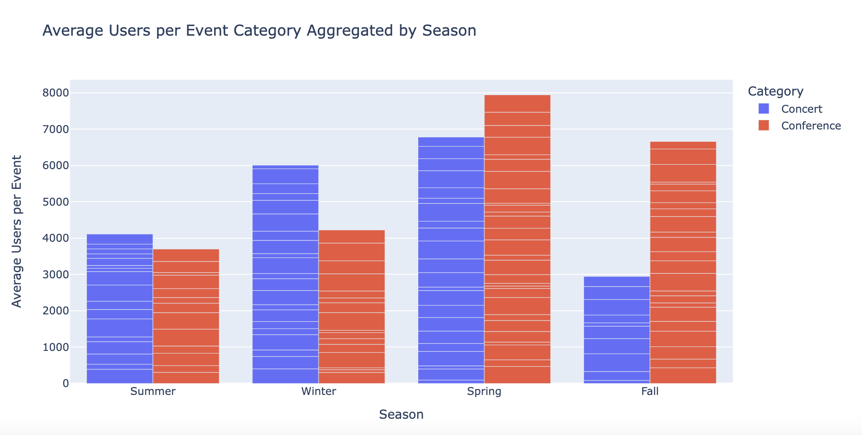
Interesting Query #1 (cont.)
We can also aggregate the data by season, determining which category performs the best depending on the season. Conferences attract more average users in the fall and spring while concerts attract more average users in the summer and winter.
Members | Company Overview | Simplified EER | Project Schema | MySQL | Queries | Normalization

Slide 22
Interesting Query #1 (cont.)
T-Test and P-Value
Is it due to random chance that concerts attract more users in summer than conferences do?
We used Python to conduct a two-sample t-test to assess whether concerts are statistically more popular than conferences in the summer based on the average number of attendees per event.
P-Value: 0.36
Therefore, there is no significant difference in average number of attendees for concerts and conferences in the summer.
Based on the data and results of this test, we will not increase efforts to host more concerts in the summer because the observed difference may be due to random chance.
Members | Company Overview | Simplified EER | Project Schema | MySQL | Queries | Normalization

Slide 23
Interesting Query #2
Description
This score is an attempt to quantify user engagement across multiple actions. By weighting each action (posting, making friends, attending events, earning points), we get a score that can help identify the most active users.
Query
SELECT UserID,
(0.4 * COUNT(DISTINCT PostID) + 0.3 * COUNT(DISTINCT FriendID) + 0.2 * COUNT(DISTINCT EventID) + 0.1 * SUM(PointsValue)) AS EngagementScore
FROM User JOIN Posts ON User.UserID = Posts.UserID
JOIN Friends ON User.UserID = Friends.UserID1
JOIN Events ON User.UserID = Events.HostID
JOIN PointsSystem ON User.UserID = PointsSystem.UserID
GROUP BY UserID
LIMIT 10;
Members | Company Overview | Simplified EER | Project Schema | MySQL | Queries | Normalization

Slide 24
Methodology: Nonlinear Function
The original dataset included variables like UserID, DistinctPostIDCount, DistinctFriendIDCount, DistinctEventIDCount, and SumPointsValue. A new target variable, ComplexEngagementScore, was created using a nonlinear function of the existing variables, plus some random noise to simulate real-world data complexity.
Linear Regression: A linear regression model was chosen for its simplicity and interpretability. The model attempts to predict the ComplexEngagementScore based on the four influencing factors.
Data Splitting: The dataset was split into training (80%) and testing (20%) sets to evaluate the model's performance on unseen data.
Model Training: The linear regression model was trained on the training set.
Members | Company Overview | Simplified EER | Project Schema | MySQL | Queries | Normalization

Slide 25
Complex Engagement Score
Members | Company Overview | Simplified EER | Project Schema | MySQL | Queries | Normalization
Notes:
First we would select UserID as the unique identifier for the dataset. To calculate the user engagement score, we would have to count the number of distinct interaction for each activity and calculate the Engagement score after receiving the count. This gives certain weights [give example of like 40%] to each activity based on how much they would reveal about User Engagement [and explain complex user engagement score]
The final step would be to join all the tables together to receive the whole picture of the dataset. The User Engagement Score is out of 15.

Slide 26
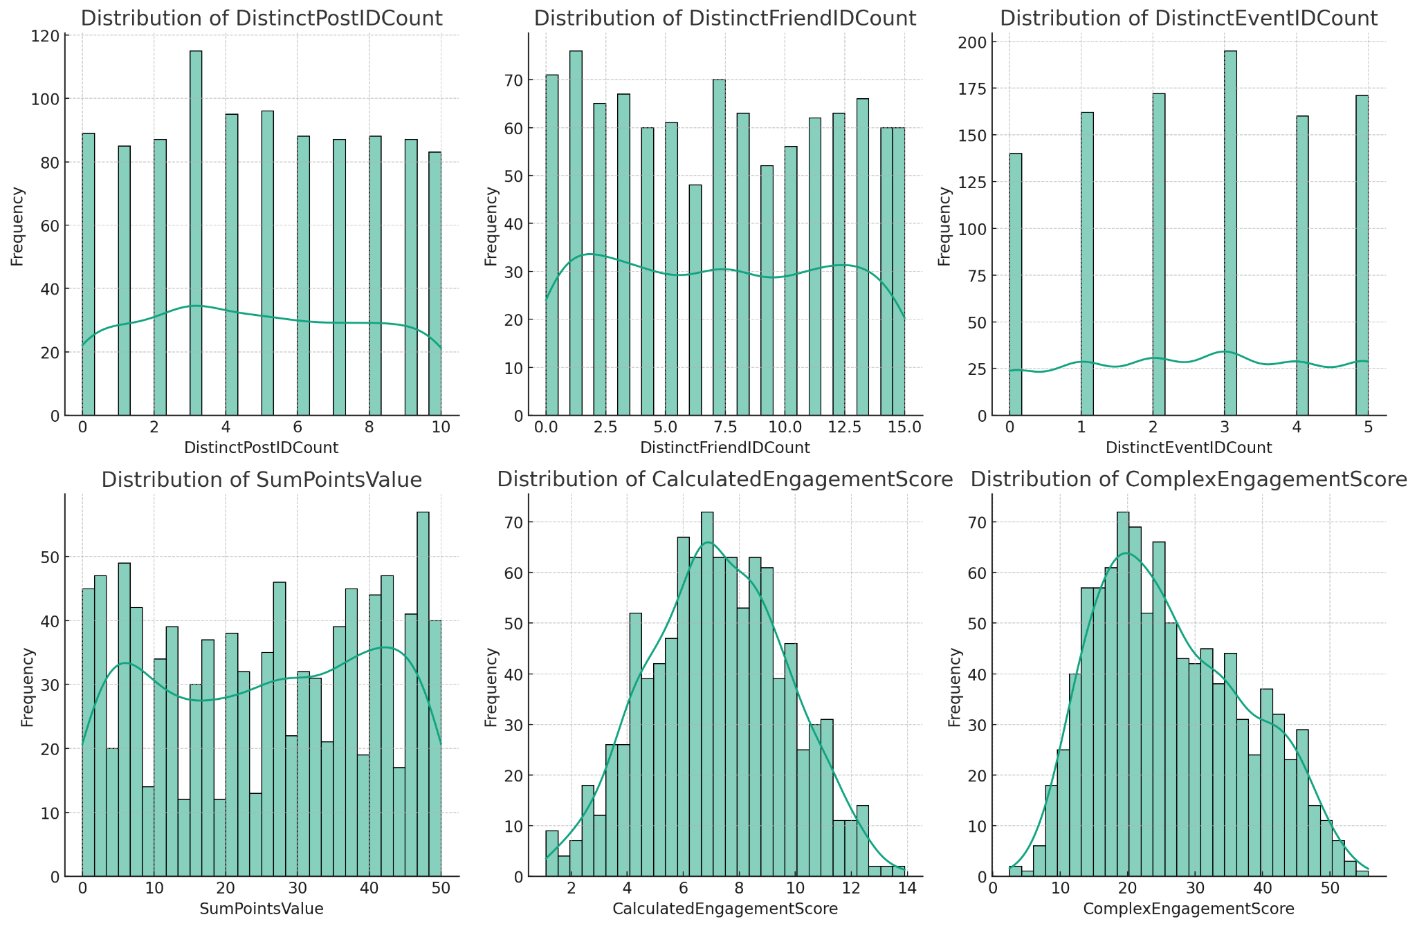
Distribution of Synthetic Data
This will help us understand if there are any characteristics that might be influencing the performance of the regression models.
Members | Company Overview | Simplified EER | Project Schema | MySQL | Queries | Normalization
Notes:
First we would select UserID as the unique identifier for the dataset. To calculate the user engagement score, we would have to count the number of distinct interaction for each activity and calculate the Engagement score after receiving the count. This gives certain weights [give example of like 40%] to each activity based on how much they would reveal about User Engagement [and explain complex user engagement score]
The final step would be to join all the tables together to receive the whole picture of the dataset. The User Engagement Score is out of 15.

Slide 27
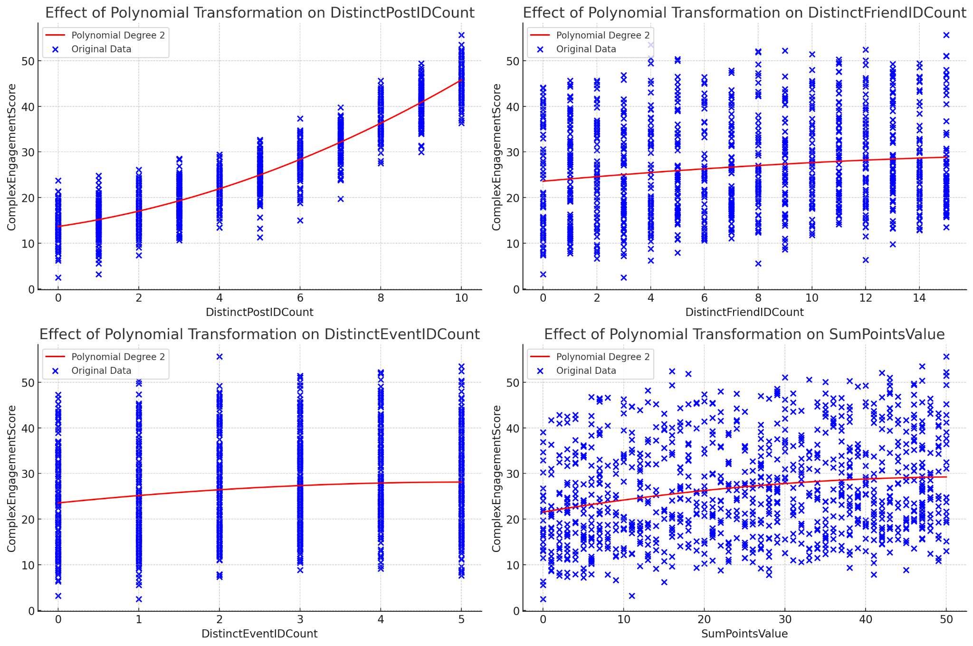
Effects of Polynomial Transformation
See how each original feature individually relates to the target variable before and after the polynomial transformation.
Members | Company Overview | Simplified EER | Project Schema | MySQL | Queries | Normalization
Notes:
First we would select UserID as the unique identifier for the dataset. To calculate the user engagement score, we would have to count the number of distinct interaction for each activity and calculate the Engagement score after receiving the count. This gives certain weights [give example of like 40%] to each activity based on how much they would reveal about User Engagement [and explain complex user engagement score]
The final step would be to join all the tables together to receive the whole picture of the dataset. The User Engagement Score is out of 15.

Slide 28
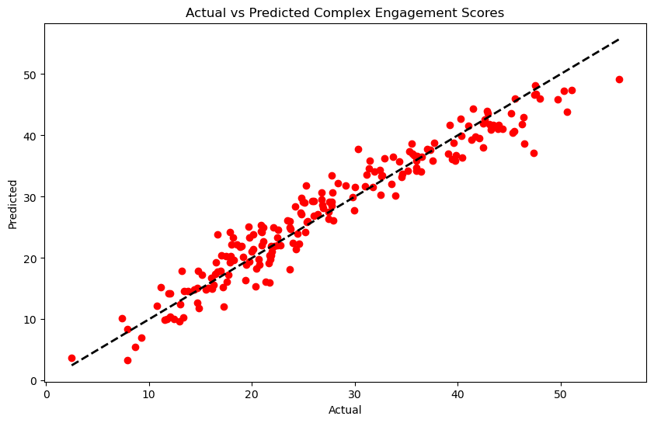
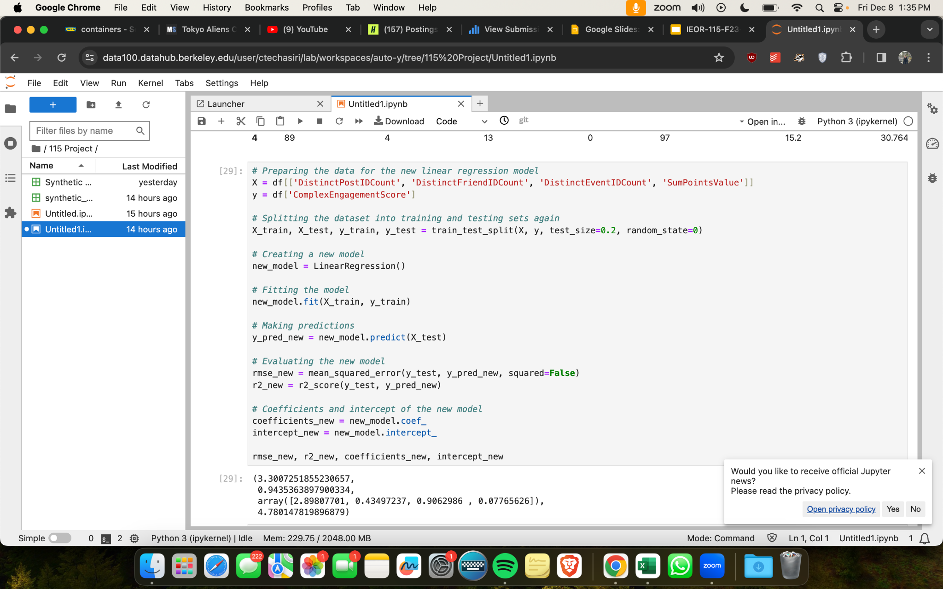
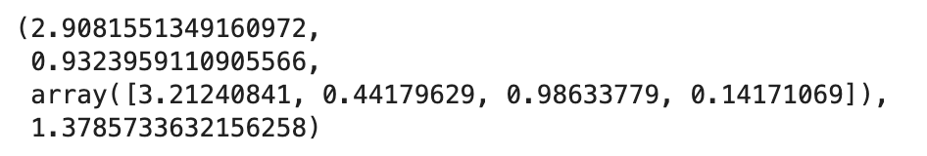
Nonlinear Function Regression
A scatter plot of actual vs. predicted engagement scores was created, showing how the model's predictions compared with the actual data.
Members | Company Overview | Simplified EER | Project Schema | MySQL | Queries | Normalization

Slide 29
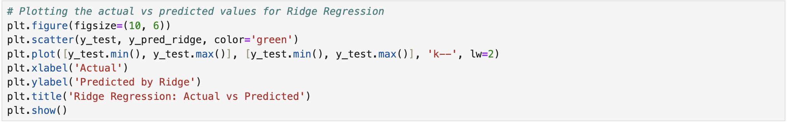
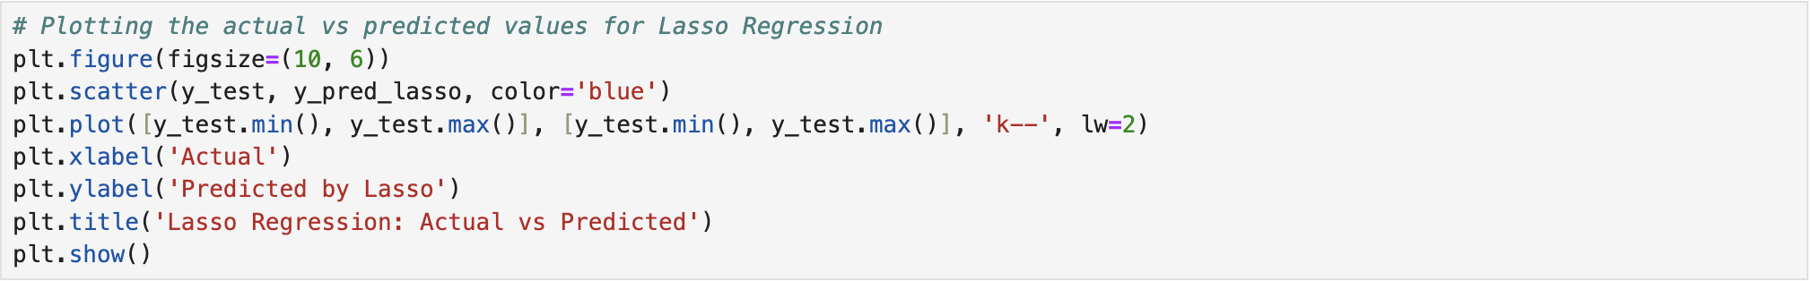
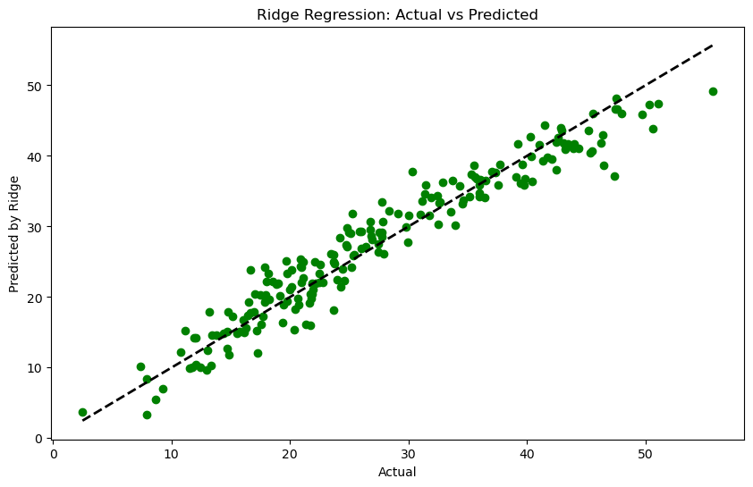
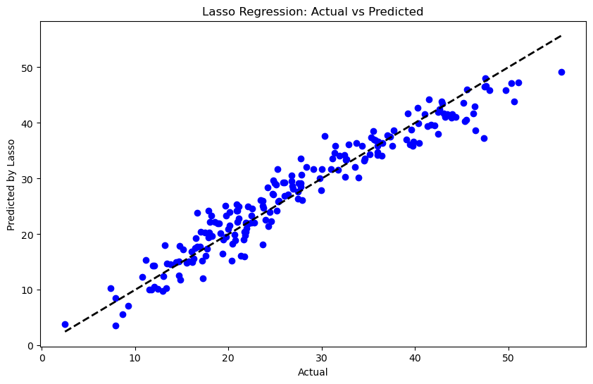
Ridge and Lasso Regression
This graph plots the actual engagement scores against the scores predicted by the Ridge Regression model.
Similarly, this graph depicts the actual engagement scores versus the scores predicted by the Lasso Regression model.
Members | Company Overview | Simplified EER | Project Schema | MySQL | Queries | Normalization

Slide 30
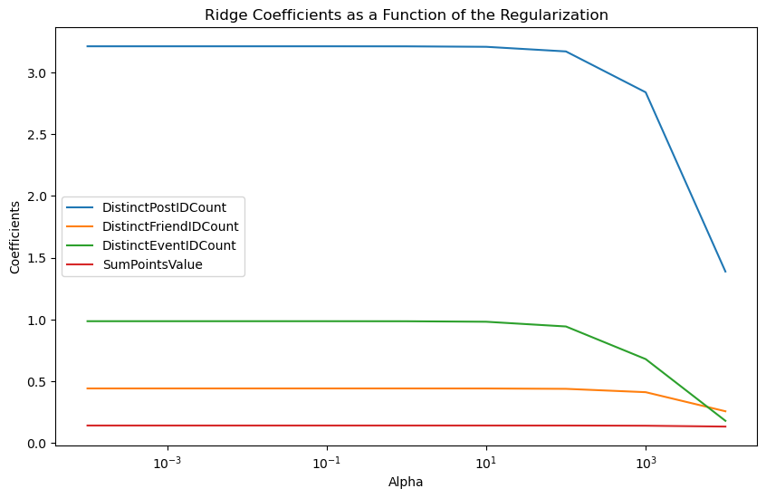
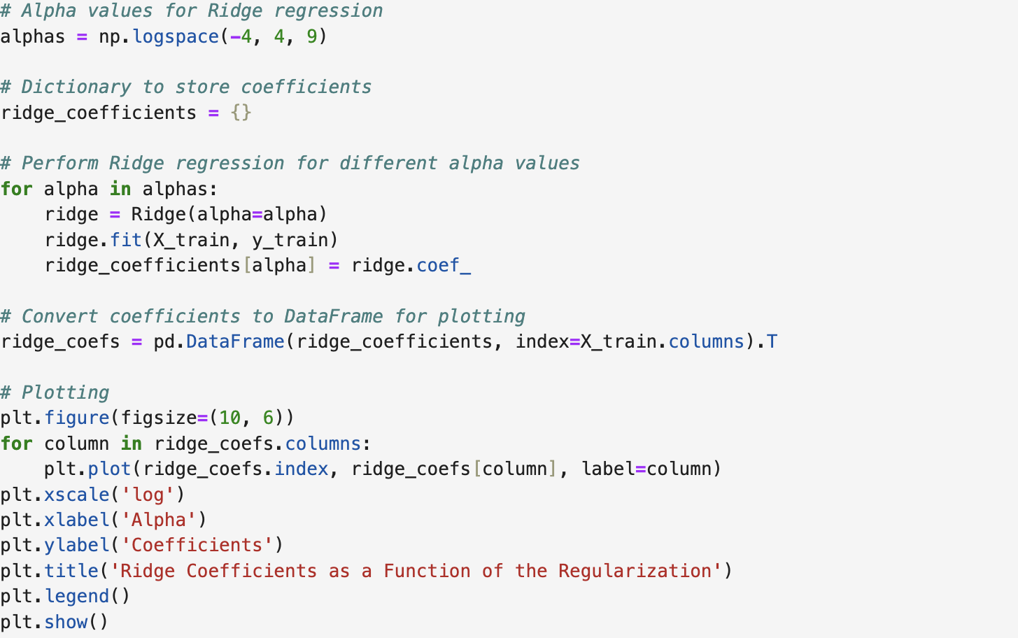
Different Alphas for Ridge Regression
The graph provides insights into how Ridge Regression controls feature coefficients based on the level of regularization.
Members | Company Overview | Simplified EER | Project Schema | MySQL | Queries | Normalization

Slide 31
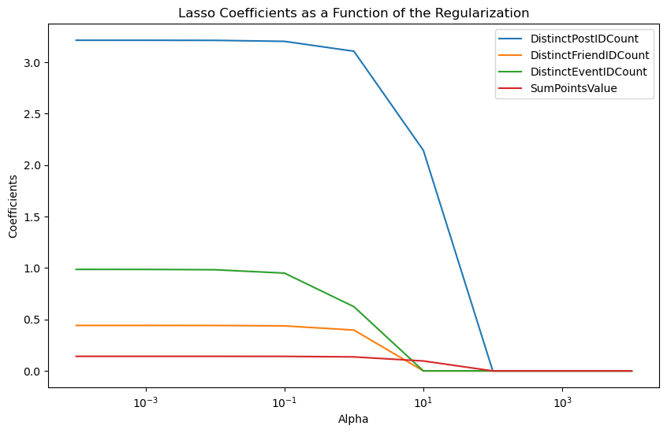
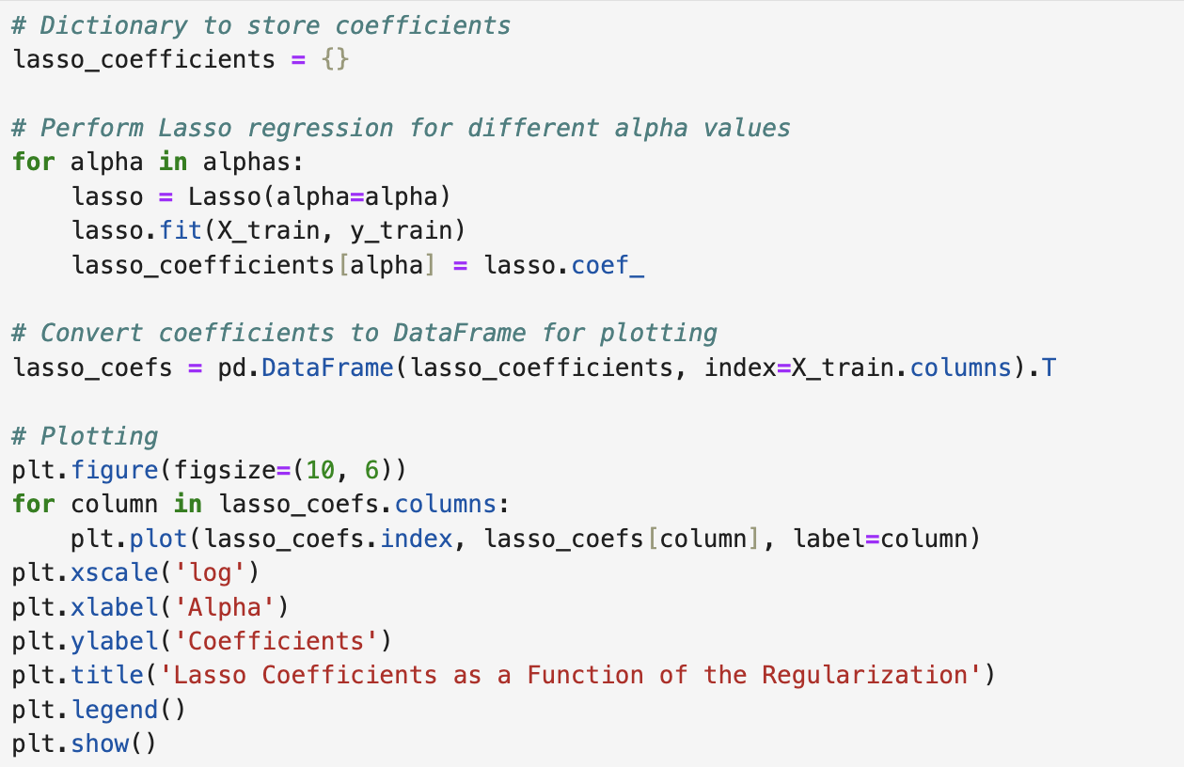
Different Alpha for Lasso Regression
This graph illustrates how changes in the variance of input features affect the performance of a linear regression model.
Members | Company Overview | Simplified EER | Project Schema | MySQL | Queries | Normalization

Slide 32
Business Implications
Tailored Product Enhancements
The regression allows Popper to strategically tailor its product enhancements to amplify user experience in areas identified as key drivers.
For example, if the model assigns high weight to event attendance, Popper might introduce features that enhance event discoverability, improve event-related interactions, or provide exclusive rewards tied to event participation.
Precision in User Targeting
Popper can design targeted marketing campaigns that resonate with user preferences, driving higher engagement.
For example, if the model highlights posts as a significant driver, marketing efforts can emphasize the social aspect of sharing content, encouraging users to contribute more actively to the platform.
Download Link for the Regression Analysis
Members | Company Overview | Simplified EER | Project Schema | MySQL | Queries | Normalization

Slide 33
Normalization

Slide 34
Normalization Analysis
Relation 1
USER (User_ID, Name, Email, Location, Age, Gender, City_ID⁵)
Functional Dependencies:
{User_ID} -> {Name, Email, Age, Gender}
{City_ID} -> {Location}
{Name} -> {Email}
Already in 1NF (all attributes single-valued) and 2NF (no partial dependencies), but contains a transitive dependencies so it violates 3NF
Here Name functionally determines Email, and Name is not a candidate key
To fully Normalize, begin by normalizing into 3NF and determine if it is also in BCNF or if further normalization is needed
Fully Normalized Form
User(User_ID, Name, Age, Gender)
User_Email(Name, Email)
City(City_ID, Location)
Members | Company Overview | Simplified EER | Project Schema | MySQL | Queries | Normalization

Slide 35
Normalization Analysis
Relation 11:
EVENT(Event_ID, Time, Date, City, Category, Description, Num_Attendees, City_ID⁵, Target_ID ¹²)
Functional Dependencies:
{Event_ID, Target_ID} -> {Time, Date, Category, City, Description, Num_Attendees}
{City_ID} -> {City}
{Target_ID} - > {Category}
Satisfies 1NF(all attributes are single-valued) and 2NF (no partial dependencies)
There is a transitive dependency we need to get rid of to satisfy 3NF. Decomposition of 3NF results in also being in BCNF.
Fully Normalized Form
Event(Event_ID, Time, Date, City, Category, Description, Num_Attendees)
Location(City_ID, City)
Target_Category(Target_ID, Category)
Members | Company Overview | Simplified EER | Project Schema | MySQL | Queries | Normalization

Slide 36
Normalization Analysis
Relation 13:
ACCOUNT (Account_ID, User_ID¹Creation_Date, Last_Login_Date, Has_User_ID¹, Login_User_ID¹)
Functional Dependencies:
{Account_ID, User_ID} -> {Creation_Date, Last_Login_Date, Login_User_ID}
{Login_User_ID} -> {Last_Login_Date}
{User_ID} - > {Account_ID}
In 3NF(no transitive dependencies) but NOT in BCNF
(Non-superkey determines another non-prime attribute)
(User_ID) is not a super-key
BCNF User_Account(User_ID¹, Account_ID, Has_User_ID¹)
Account_Info(Account_ID, User_ID¹, Creation_Date, Last_Login_Date, Login_User_ID)
Members | Company Overview | Simplified EER | Project Schema | MySQL | Queries | Normalization
Notes:
Boyce codd normal form

Slide 37
Normalization Analysis
Relation :
CHAT (Chat_ID, User_ID¹, Message_Text, No_Participants, Creates_User_ID¹)
Functional Dependencies:
{Chat_ID} -> {Message_Text}
{Creates_User_ID} -> {User_ID}
{Chat_ID, User_ID} -> {Message_Text, No_Participants}
In 2NF(no partial dependencies) but NOT in 3NF
Transitive dependency exists, further normalization is needed. 3NF decomposition, contains a non-trivial functional dependencies where the determinant is a super key. Therefore further normalization needed to be in BCNF
Fully Normalized Form
Chat_Info(User_ID¹, Creates_User_ID, Message_Text, No_Participants)
User_Info(Creates_User_ID, User_ID¹)
Members | Company Overview | Simplified EER | Project Schema | MySQL | Queries | Normalization
Notes:
Boyce codd normal form

Slide 38
Normalization Analysis
Relation :
COMMENTS (User_ID, Post_ID⁸, No_Likes, Liked_By, Text)
Functional Dependencies:
{Post_ID⁸} -> {No_Likes, Text }
{User_ID, Post_ID⁸} -> {Liked_By}
{User_ID} -> {Post_ID}
In 1NF since all attributes are single- valued
Not in 2NF since Non-prime attribute No_Likes and Text don’t depend on the whole key
Begin by normalizing into 3NF, relations in 3NF decompositions do not have any non-trivial functional dependencies where the determinant is a super key. Therefore, also in BCNF
Fully Normalized Form
Post(Post_ID⁸, No_Likes, Text}
User_Post_Liked(User_ID, Post_ID⁸, Liked_By}
User_Post(User_ID, Post_ID⁸}
Members | Company Overview | Simplified EER | Project Schema | MySQL | Queries | Normalization
Notes:
Boyce codd normal form

Slide 39
THANK YOU!

Slide 40
Discussion + Reflection
Throughout this project, working with a client was definitely a plus side of this whole process. We were able to get feedback from both our professor as well as client in order to make the best possible database. In regards to what went well, we were able to pace ourselves and make good progress throughout the whole semester without feeling overwhelmed. By applying what we learned in class, the concepts were able to stick with us and allow us to get practice. In addition, despite having a lot of people in one team, we were all able to contribute our share of work and create a database that all of us approved of. One thing that was also enjoyable was creating the EER diagram.
For what we could have done differently next time, more meetings with the client throughout the semester could have been a bit more of a help. When we did have meetings, they were very productive, and helped lead us to the right path, so more of these types of meetings could possibly enable us to make a better database.
In the future, we believe that we could definitely improve the queries we have by looking more into specifics. For example, we could look deeper into queries such as for users who gave an average of 3 star reviews, what kind of events did they go to? Can we predict the next event the user will go to and what score they would give it? In addition, we could also expand our database to include more relations / entities. This goes hand in hand with more queries as if we had more entities, that gives us the opportunity to analyze them and see if there are any more correlations or patterns we would not have previously imagined.
Members | Company Overview | Simplified EER | Project Schema | MySQL | Queries | Normalization
Notes:
Boyce codd normal form

